Slide 1
Prehension data organization
2023-03-22

Slide 2
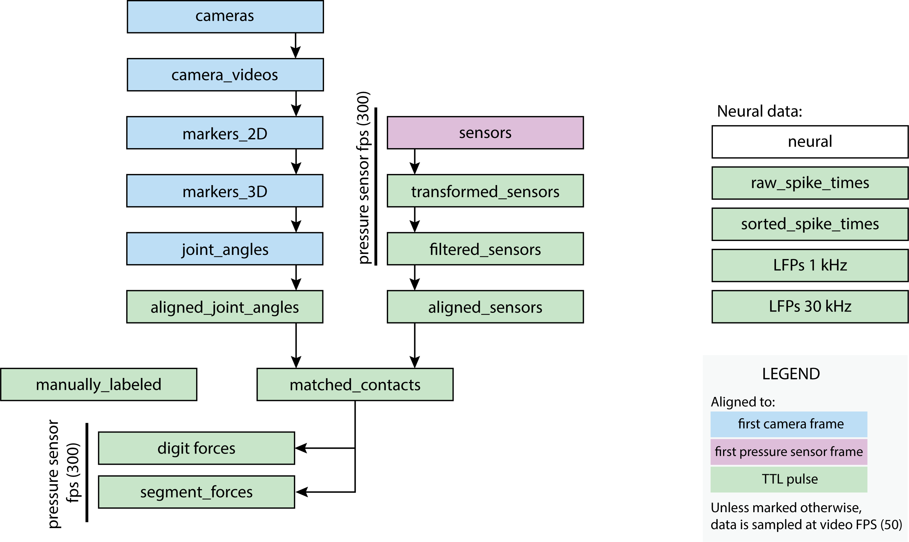
Overview

Slide 3
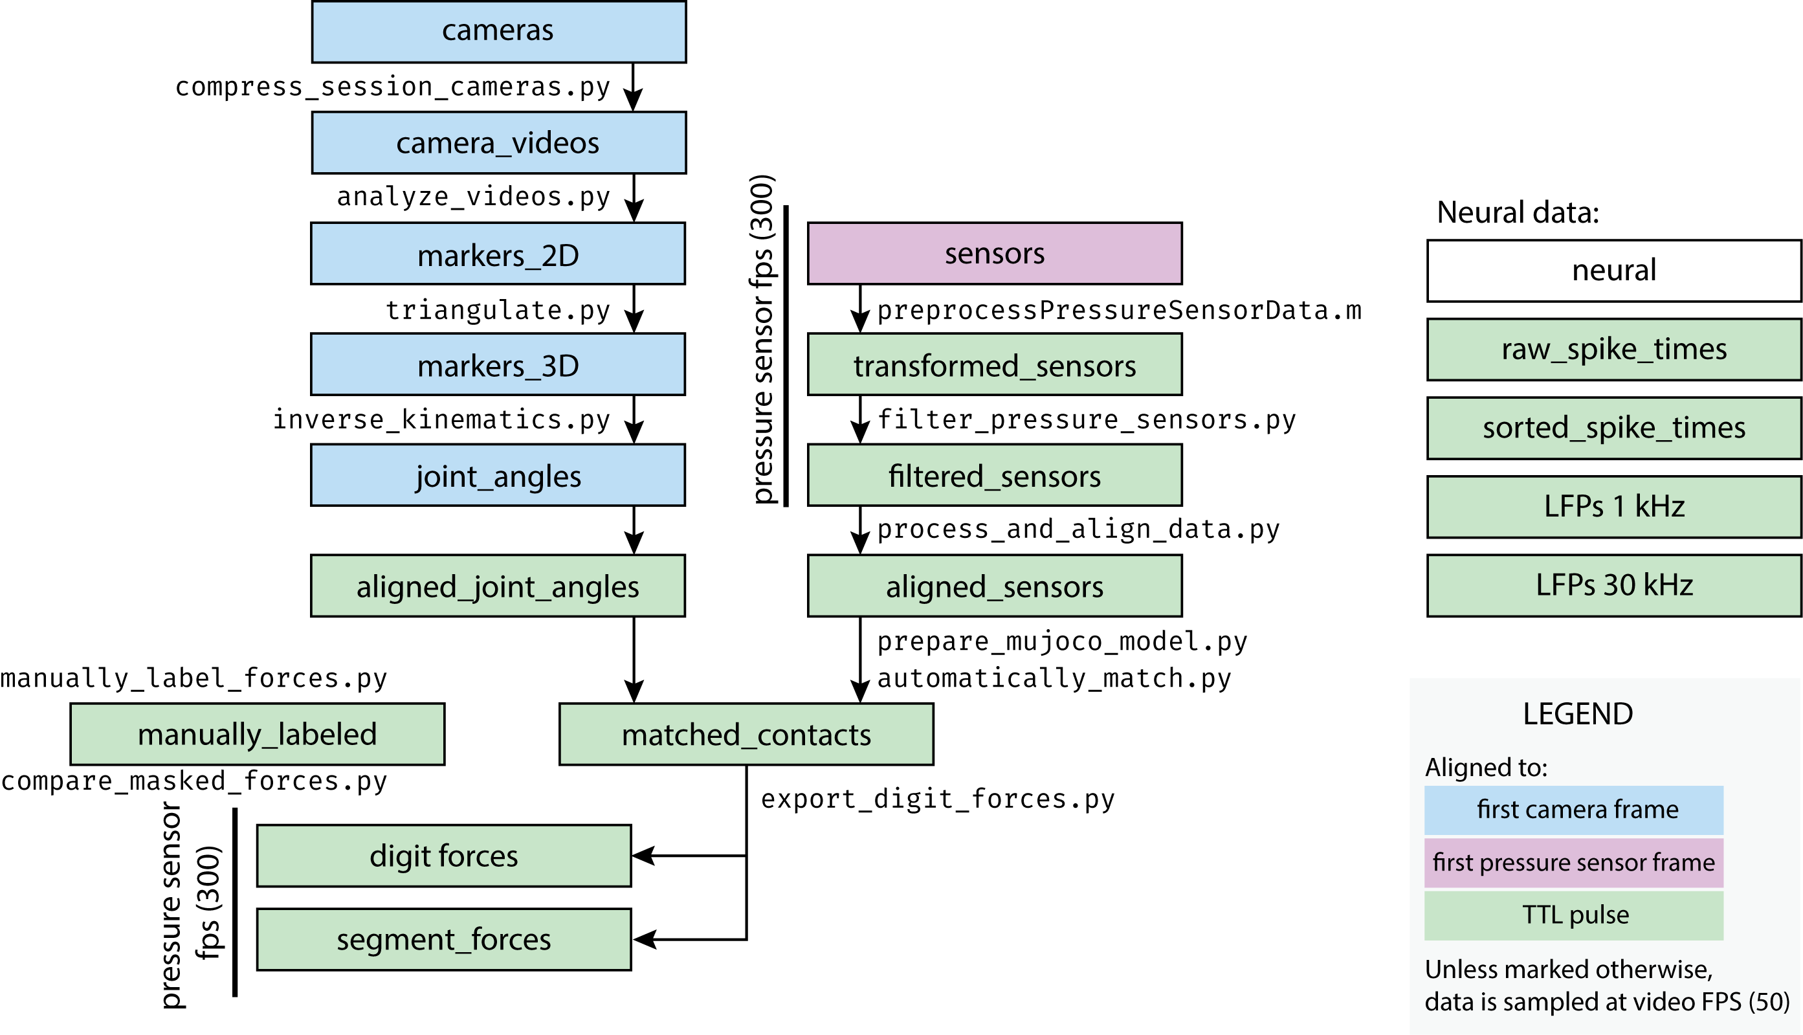
Overview – major functions

Slide 4
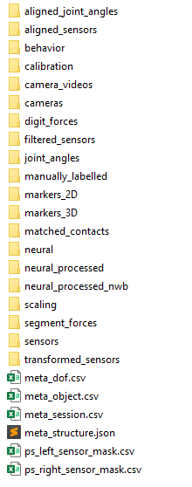
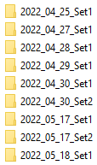

Overview – folder structure
processed
raw
special
Animal and Implant
Session name
meta
Date in standard format + note

Slide 5
Major notes – languages
Most code specifies Python 3.7
DeepLabCut machine vision works on Python 3.8
Depends on your install of CUDA/cudnn
OpenSim IK requires custom OpenSim Python API and Python 3.8
MuJoCo executable was built for Windows x64

Slide 6
Required code/packages
NCams: https://github.com/CMGreenspon/NCams
Loading/saving files
Triangulation
Reporting pool: https://github.com/nishbo/reporting_pool
Tracking parallel processes and reporting on errors
TSM: https://github.com/nishbo/timed_sparse_matrix
Importing and exporting timed sparce matrices from C++/MATLAB/Python
Needed for any work with pressure sensor data

Slide 7
Required code/packages
DeepLabCut: https://github.com/DeepLabCut/DeepLabCut
Install the latest version for applying
Use our fork for creating training data: https://github.com/nishbo/DeepLabCut
OpenSim:
Compile from source, build Python 3.8
Our fork: https://github.com/nishbo/opensim-core

Slide 8
Major notes – presets
Python code runs from command line
First argument should be preset – full or short name from preset.py

Slide 9
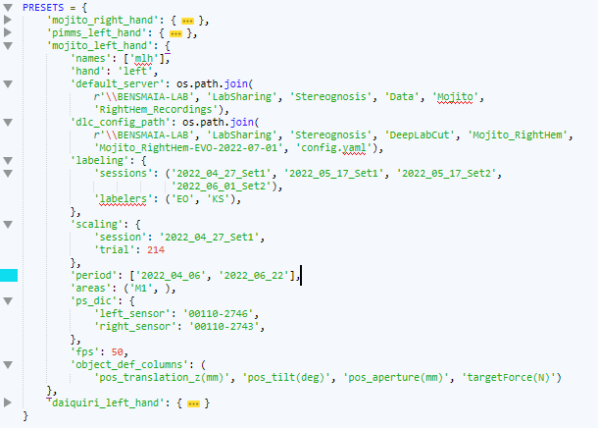
preset.py
Name
Left/right hand
Location of data
etc.
Most fields are only needed to generate the session-specific meta information.
Helps switch between animals.

Slide 10
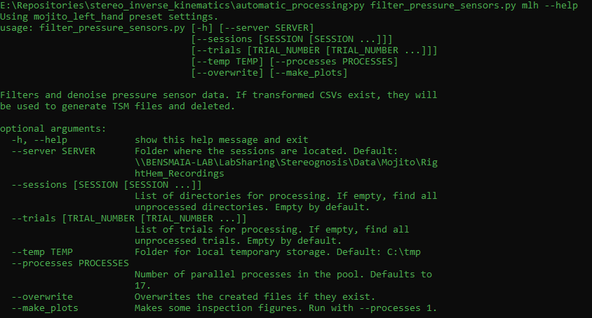
Major notes – other cmd arguments
The rest of accepting arguments can be seen using --help keyword.

Slide 11
Major notes – other cmd arguments
The rest of accepting arguments can be seen using --help keyword.
Common arguments:
--sessions: one or more sessions to process
--trials: one or more trials to process
--overwrite: if the product files exist, they will be overwritten. Use with caution
--processes: number of parallel processes to use. Defaults to a lot.

Slide 12
Steps in detail
1. preprocessing

Slide 13
Parsing meta information
create_meta.py:
Reads logs, identifies cameras, repackages data, generates:
meta_dof.csv – information on degrees of freedom;
meta_object.csv – lists all different object properties;
meta_session.csv – lists all trials, their objects and timings;
meta_structure.json – directories, names of sensors, calibration, etc.

Slide 14
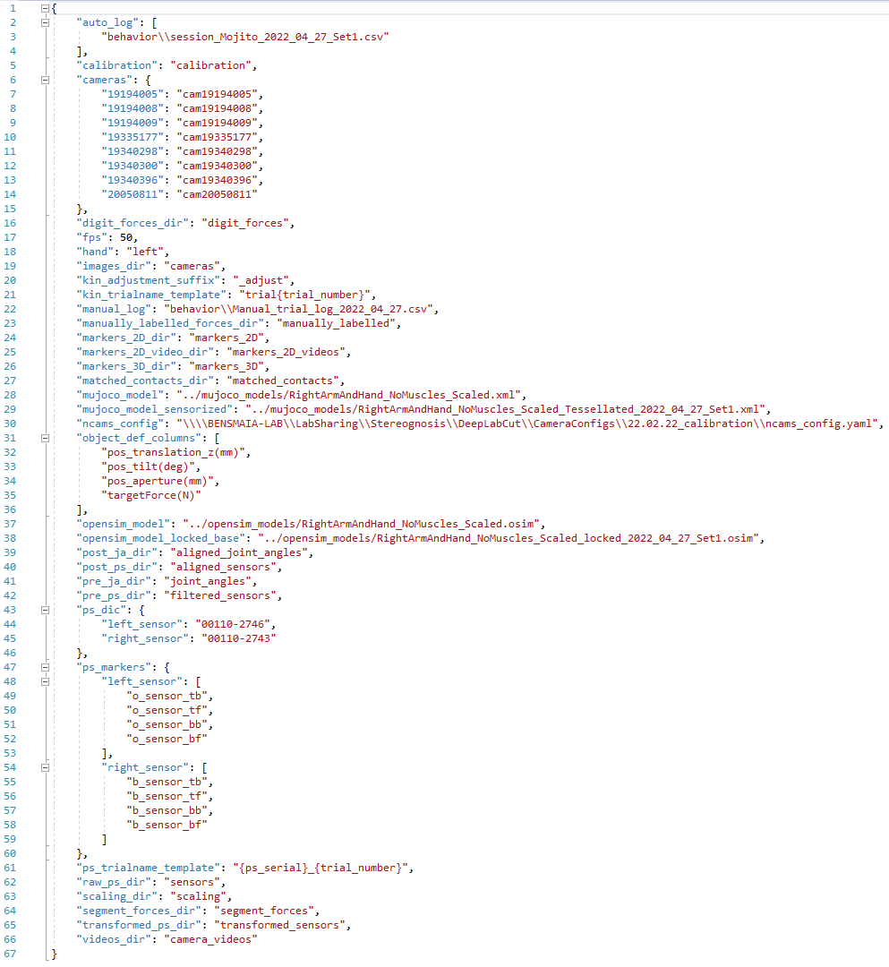
meta_structure.json
Relative directories
Filename templates
Definitions copied from preset
Session-specific model names

Slide 15
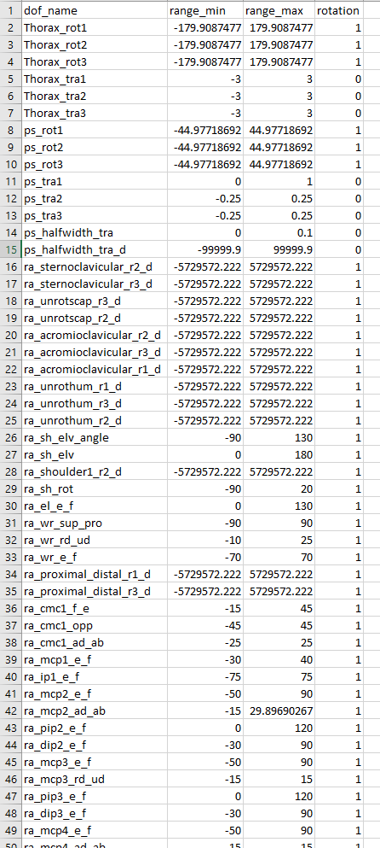
meta_dof.csv
Maximum allowed ROM
Is the DOF rotational or translational
For description of DOFs, see:
https://github.com/nishbo/ms_arm_and_hand/blob/main/AAH%20Model/dofs.csv
DO NOT USE dependent (_d) DOFs in analysis

Slide 16
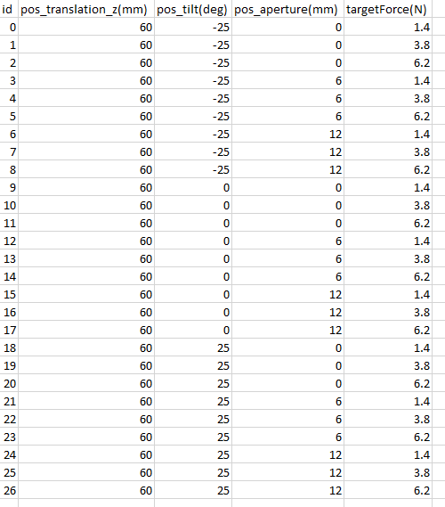
meta_object.csv
Reference table for object ID and its description

Slide 17
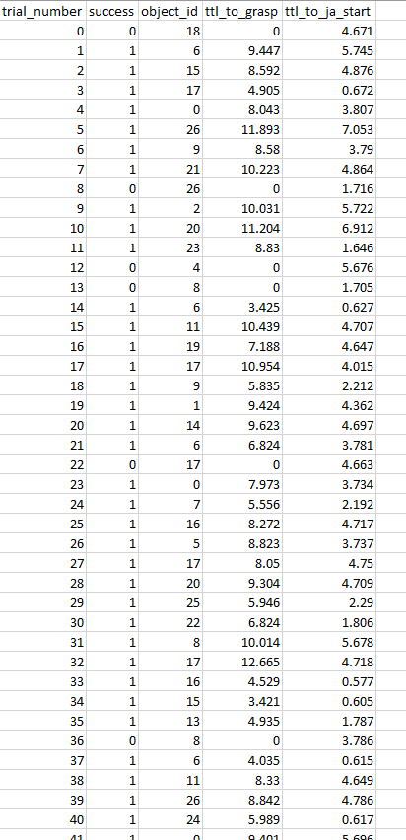
meta_session.csv
Reference table for:
trial number
object ID
some timing information

Slide 18
Additional scripts
rename_folders.py
Changes the names of some folders in each session.
Useful when structure of data has changed, e.g. processed_sensors -> transformed_sensors.

Slide 19
Steps in detail
2. pressure sensors

Slide 20
Extract data from TekScan format
preprocessPressureSensorData.m:
MATLAB – individual scripts for each trainer/monkey.
Extracts calibrated frames and saves them to TSM files.
Aligns so that time 0 is the TTL pulse ON.
Very slow extraction from TekScan.
Frames SHOULD consistently be at 300 fps, but there are frame drops.

Slide 21
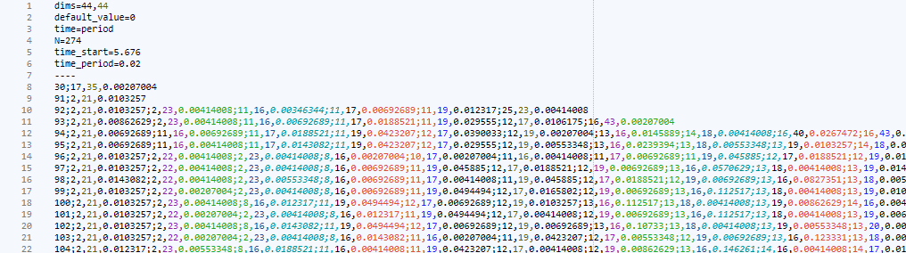
Timed Sparce Matrix format
Used for pressure sensor data
20-150 times decrease in disk space
https://github.com/nishbo/timed_sparse_matrix

Slide 22
Filter pressure sensors
filter_pressure_sensors.py:
If CSV exists (old style data), it is transformed into TSM and deleted.
Filtering:
Identify active touch period (>= 5% of max total force).
Find the 90th percentile for each sensel outside of touch period.
Everything below that threshold is 0.
Median filter with 3 frames width.

Slide 23
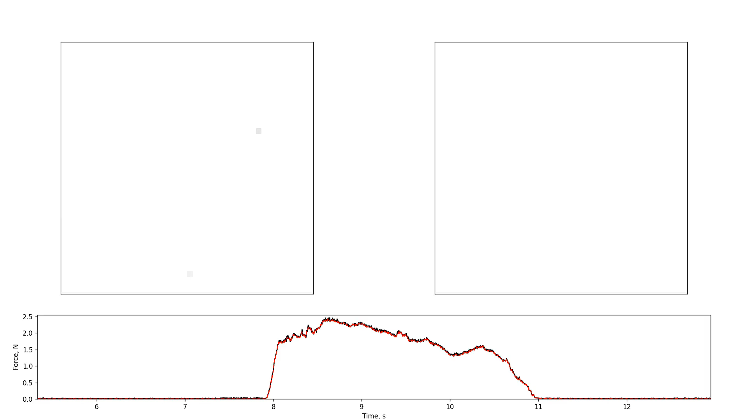
Animation of PS filtering effects
before
after

Slide 24
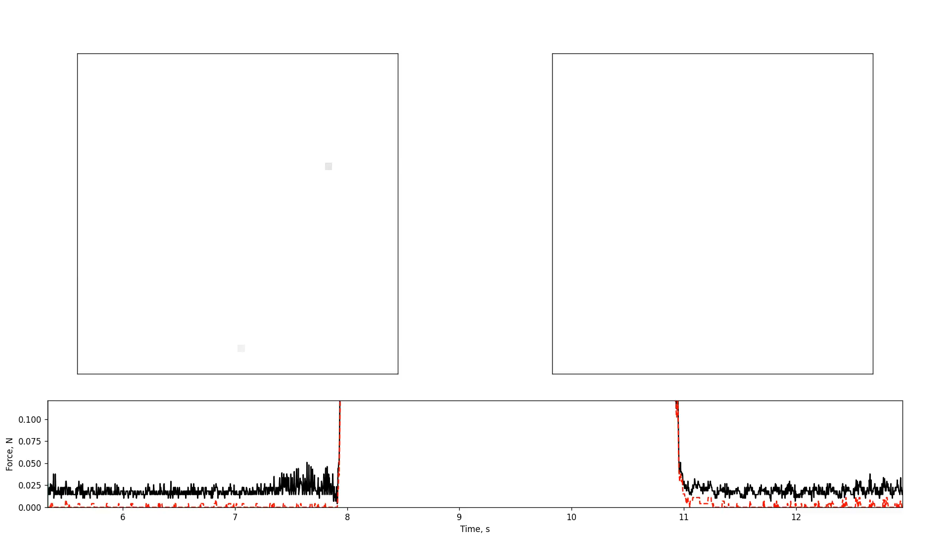
Animation of PS filtering effects
before
after

Slide 25
Steps in detail
3. Kinematics

Slide 26
Make videos
compress_session_cameras.py:
Uses FFMPEG to make videos from stored images.
Also copies over a log file with time stamps of each image.
Starting from 2023-03 the data is generated as videos.
Notes:
The following scripts needs to be updated to reflect slightly different folder structure, handle some frame drop-offs, and use Jarvis.

Slide 27
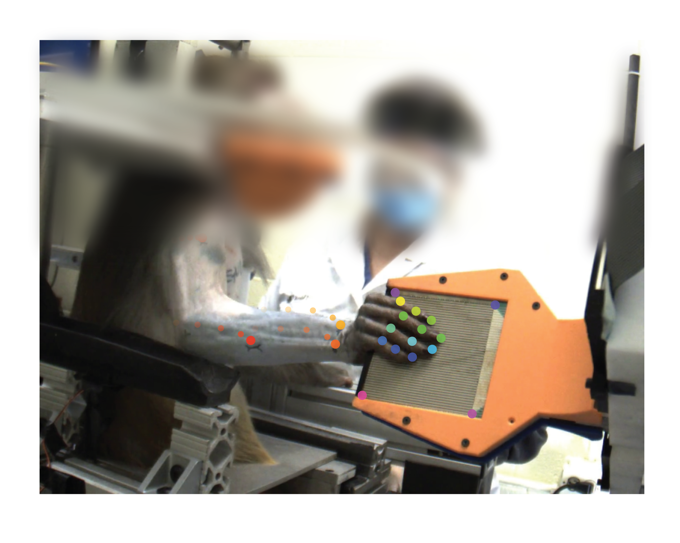
Automatic labelling
analyze_videos.py
Use a trained DeepLabCut network to estimate 2D positions of body landmarks on each frame on each camera.
Runs on GPU on a PC with properly-installed CUDA/cudnn
Python 3.8

Slide 28
Calibration
Is required to transform 2D points on the frames (locations of landmarks) to 3D points in space.
Intrinsic calibration
Extrinsic calibration

Slide 29
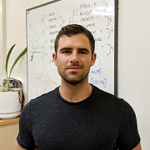
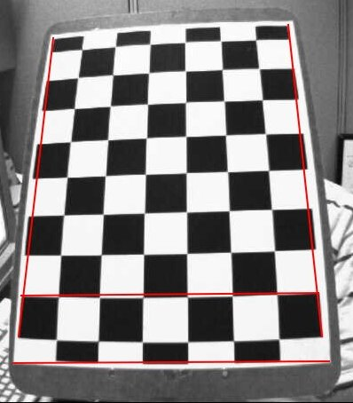
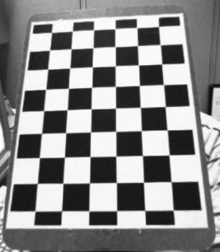
Intrinsic calibration
Corrects the effect of lens (focal length) on the image
Makes straight lines straight
Updated rarely:
\\BENSMAIA-LAB\LabSharing\Stereognosis\DeepLabCut\CameraConfigs
See Tutorial.rtf and CalibrateIndividualCameras.py

Slide 30
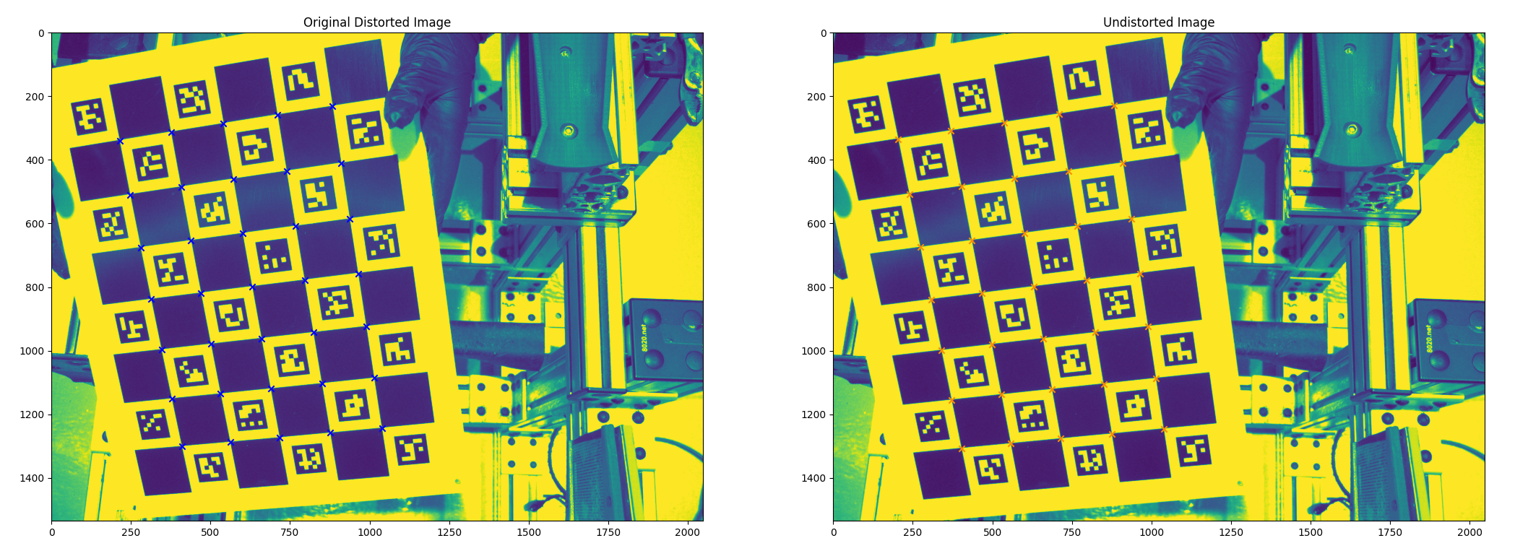
Intrinsic calibration
Corrects the effect of lens (focal length) on the image
Makes straight lines straight
Updated rarely:
\\BENSMAIA-LAB\LabSharing\Stereognosis\DeepLabCut\CameraConfigs
See readme

Slide 31
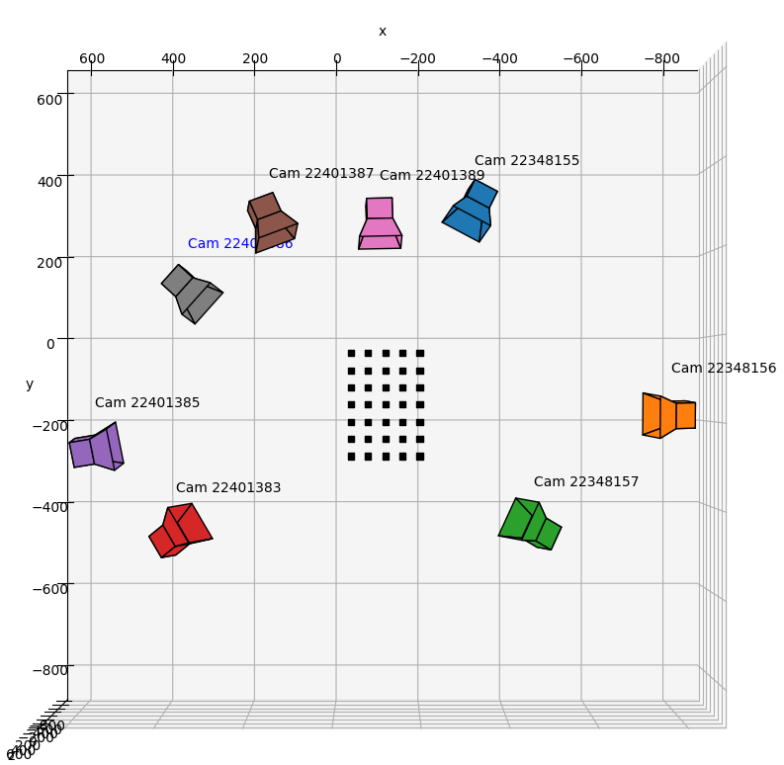
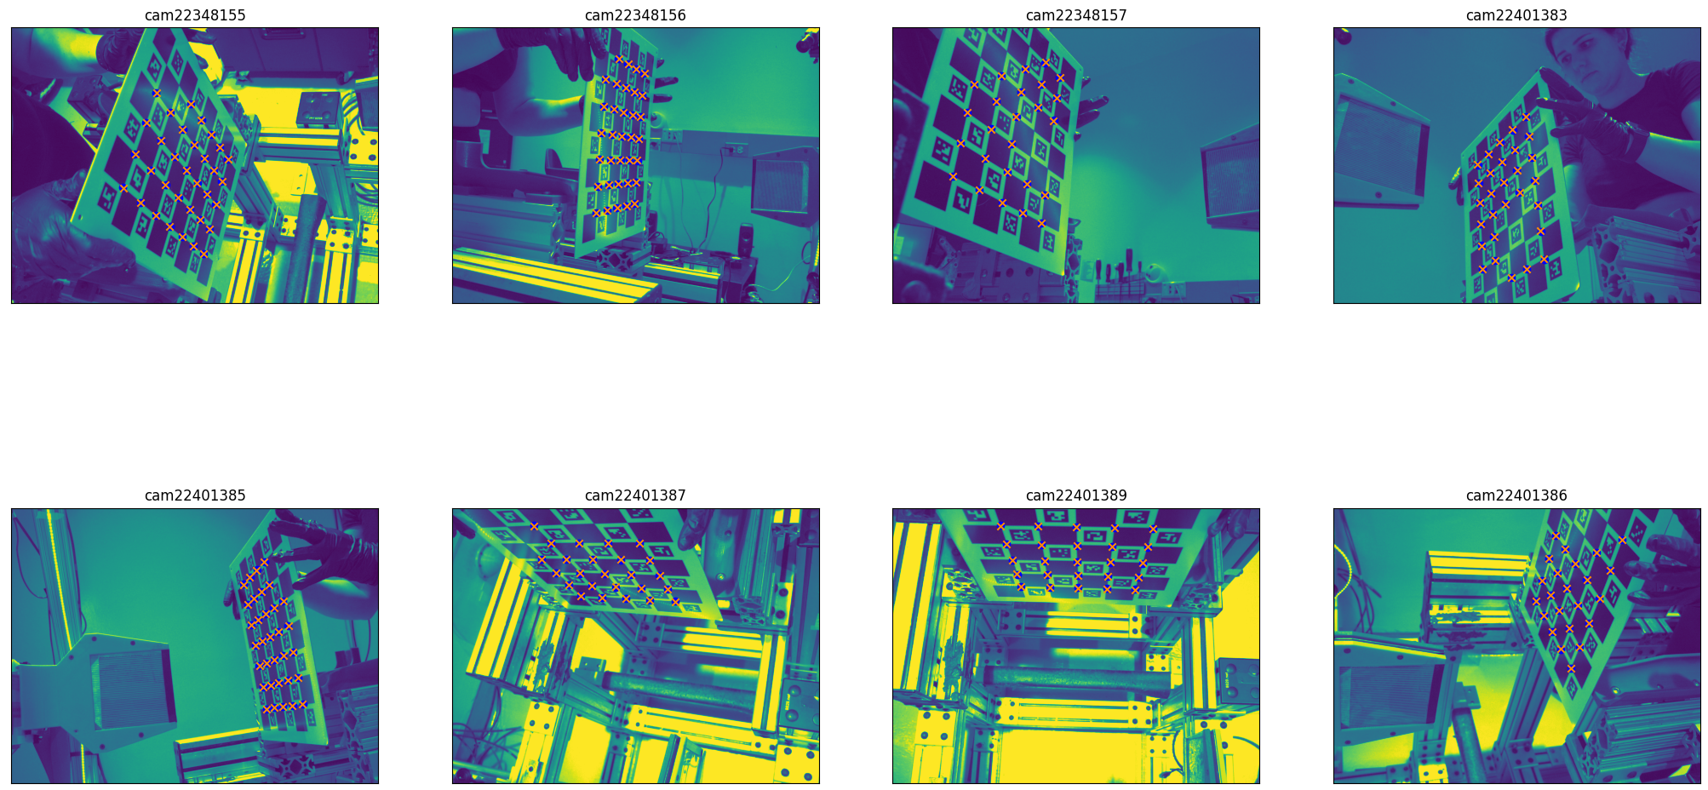
Extrinsic calibration
calibration.py
Finds the relative position and orientation of each camera
Done every session – cameras are pushed around
Also see LoadConfigAndCalibrate.py
Run both elective command line flags for the first time.

Slide 32
Triangulation
triangulate.py
Transforms 2D marker positions into locations in 3D space.
Only 2D markers with likelihood > threshold (0.4) are used.
Prepares inverse kinematic configuration files.
If the left hand was used, the markers are reflected across midline.

Slide 33
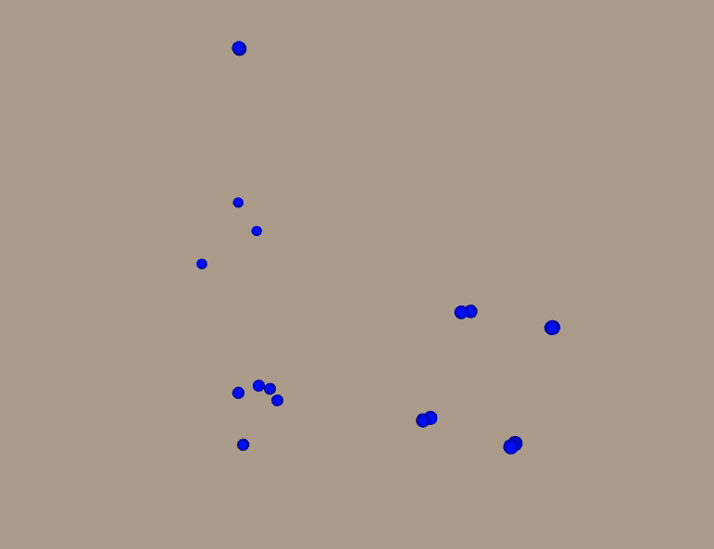
Triangulation
Preview 3D markers in OpenSim – .trc files.

Slide 34
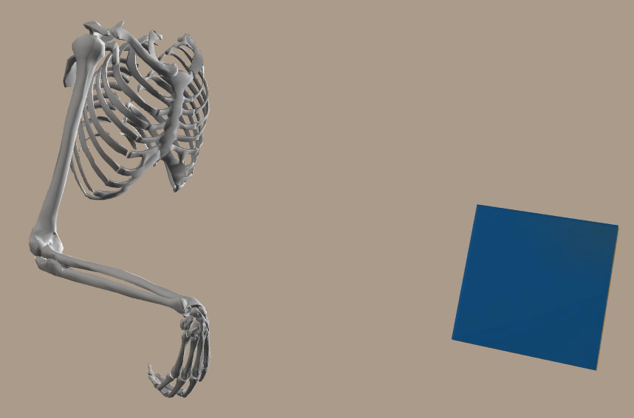
Inverse kinematics
From positions of body landmarks in 3D space to joint angles between segments of a scaled skeletal model.
Optimization problem.
Find the posture of skeletal model so that the markers rigidly attached to it match their recorded positions in 3D space.

Slide 35
Estimate position of thorax
Monkey’s body (head) is fixed.
We mostly track distal landmarks – they can pull on the body.
The body should be fixed in space for the session.
If many markers on the torso are visible, use automatic estimation.
Mojito right hand
If not, manually mark each session.
Mojito left hand

Slide 36
Estimate position of thorax: automatic
inverse_kinematics.py --base
Runs inverse kinematics only on the location/orientation of torso using positions of proximal landmarks.
find_static_thorax_position.py
Finds the median position of thorax and generates session-specific OpenSim model with thorax fixed in that posture.

Slide 37
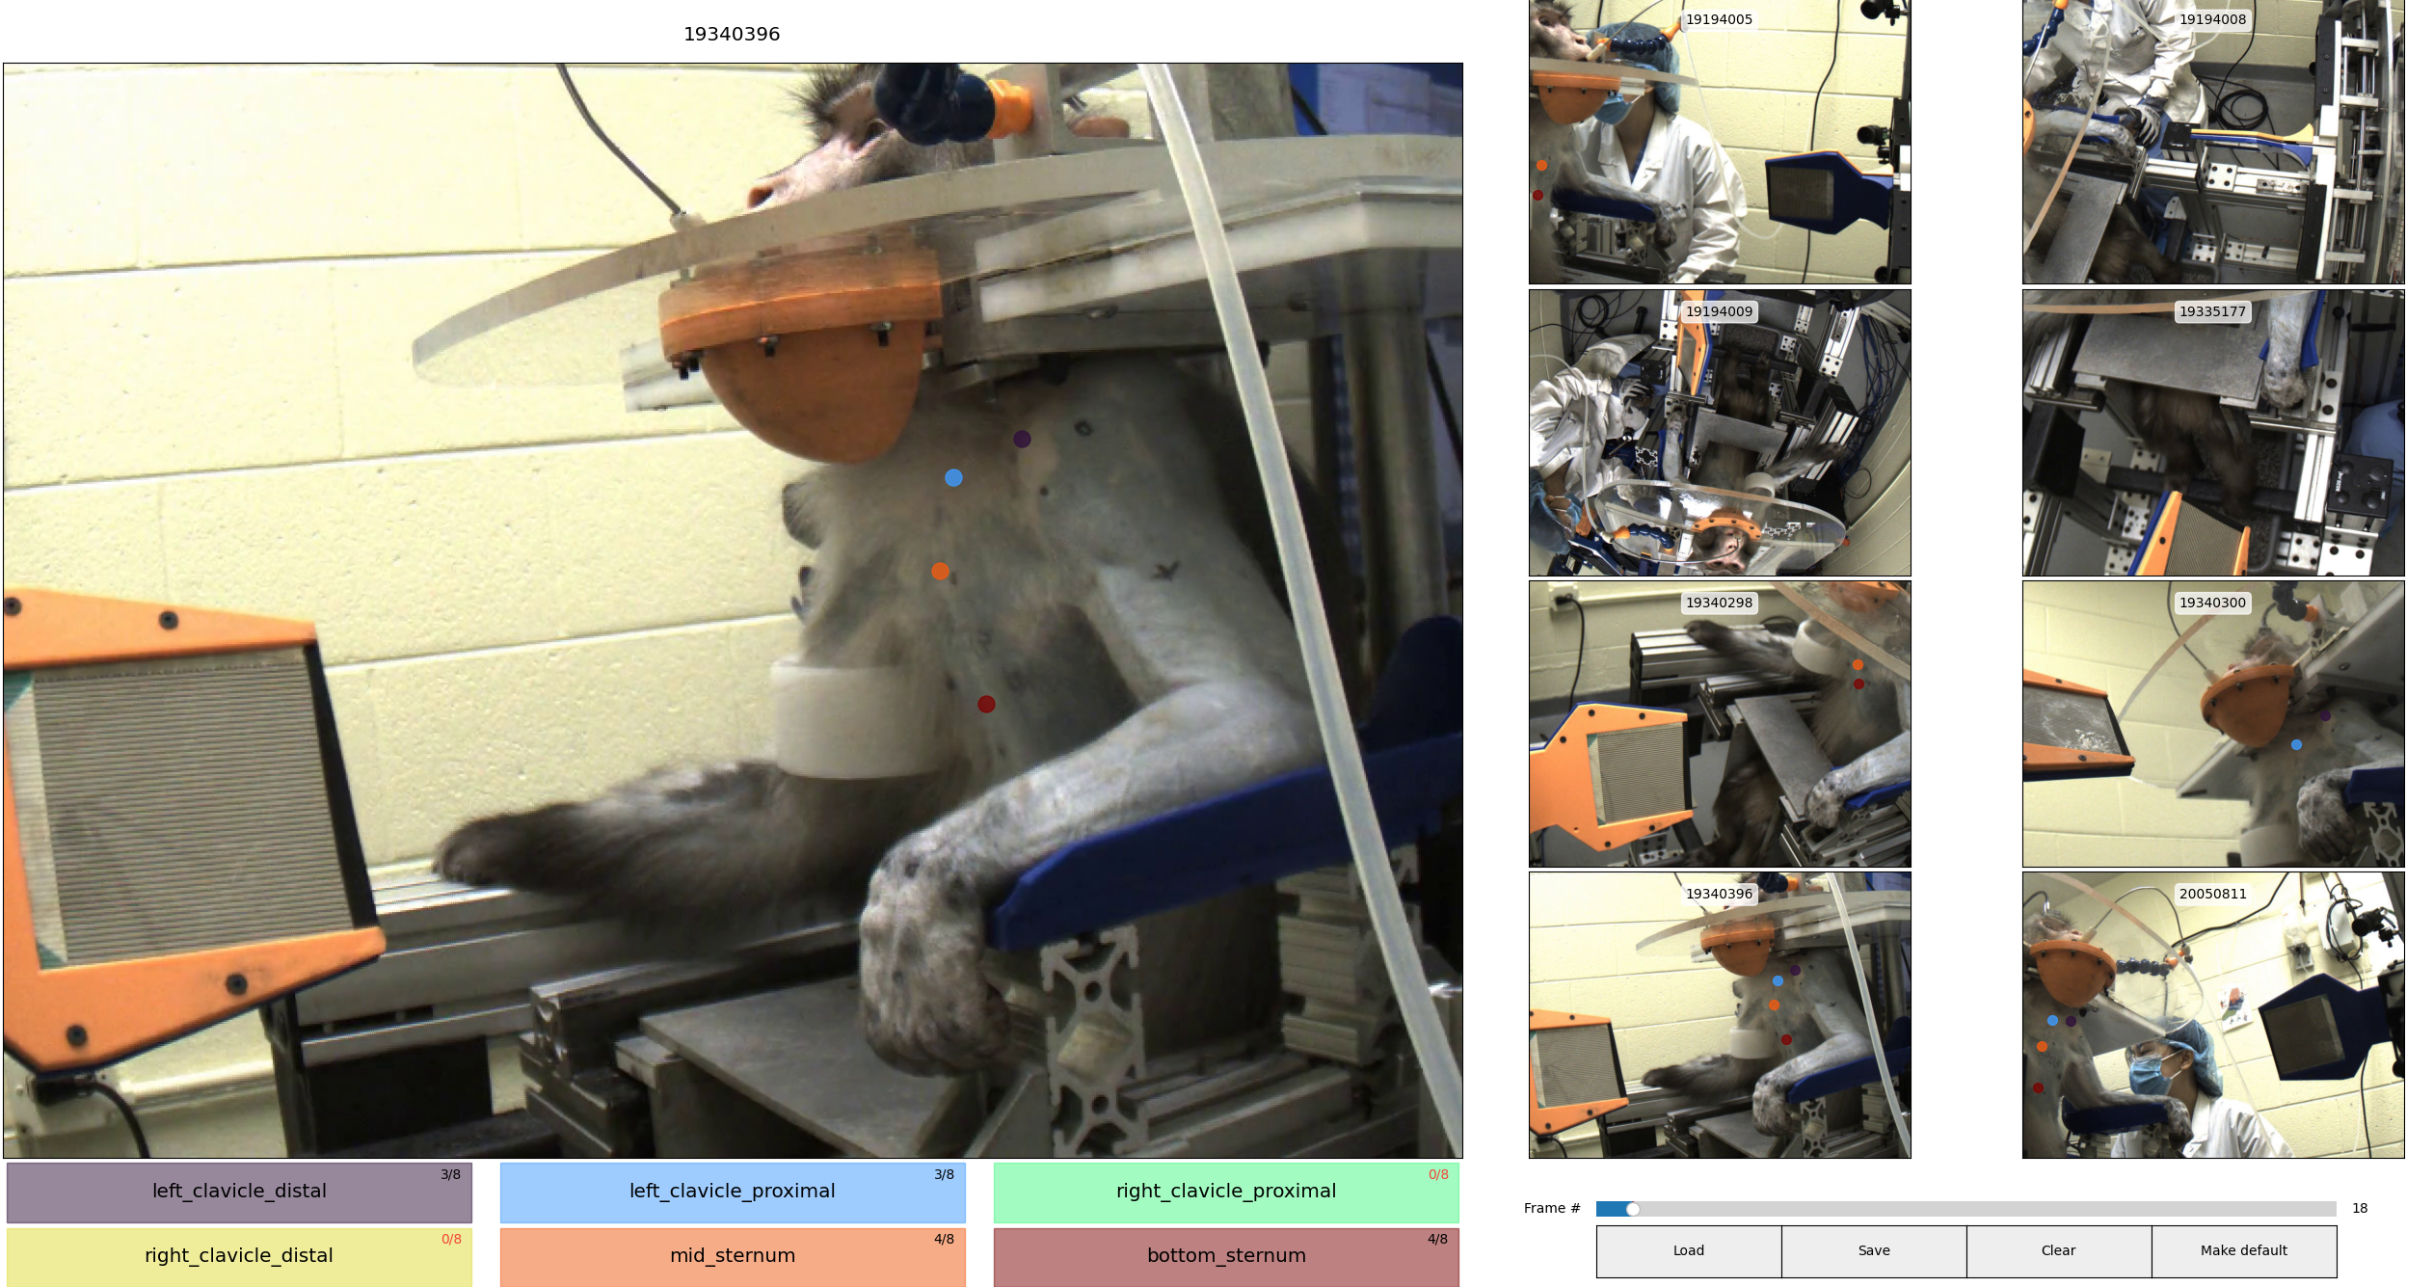
Estimate position of thorax: manual
mark_base.py
Asks to label several landmarks on the thorax from a random trial
Runs inverse kinematics on them
Generates session-specific OpenSim model with thorax fixed in that posture.
Notes:
per extrinsic calibration

Slide 38
Inverse kinematics
inverse_kinematics.py
From positions of body landmarks in 3D space to joint angles between segments of a scaled skeletal model.
Takes awhile to run – high precision.
Fork of OpenSim – allows accuracy to be dropped if the target cannot be achieved.

Slide 39
Steps in detail
4. Matching contact locations

Slide 40
Aligning data
process_and_align_data.py
Downsamples pressure sensors to the framerate of the cameras
Constrains time to period where both joint angles and pressure sensors are available
Filters pressure sensors
Filters joint angles

Slide 41
Aligning data – pressure sensors
300 fps with rare missing frames -> 50 fps with nothing missing
Custom algorithm – median downsample
Identify active touch period – from first grasp (>5% total force) until release

Slide 42
Aligning data – joint angles
2-order Butterworth low-pass filter at 20 Hz
Gaussian filter with 100 ms window
Pressure sensor location is fixed to median during active touch period
Degrees -> radians

Slide 43
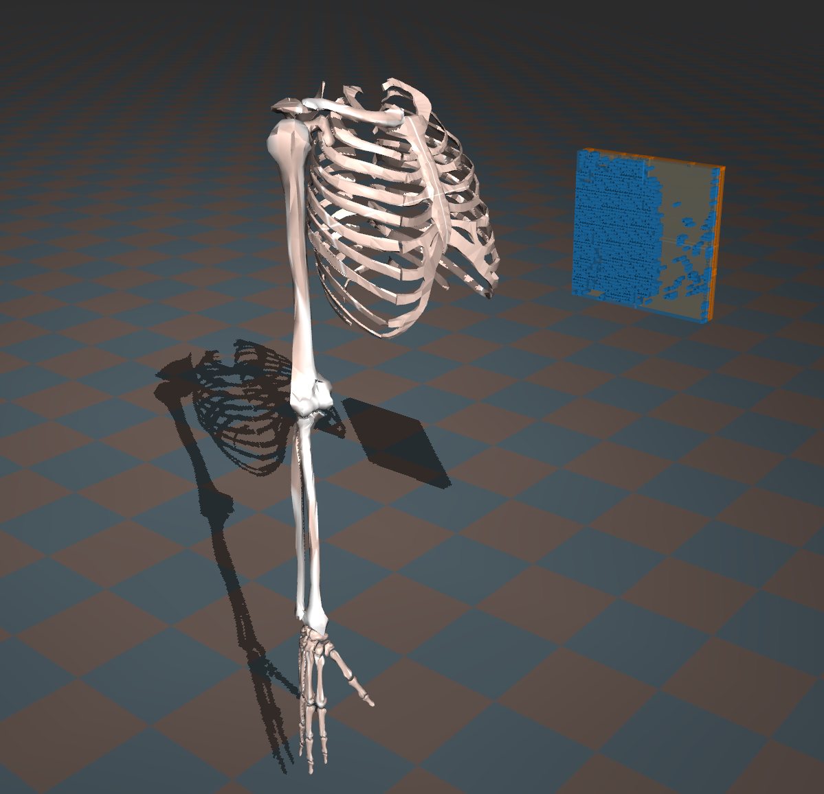
Prepare MuJoCo model
prepare_mujoco_model.py
Finds all sensels that were active during a session:
ps_left_sensor_mask.csv
ps_right_sensor_mask.csv
Generates MuJoCo model from monkey-specific MuJoCo model and the masks

Slide 44
Match the forces with segments
automatically_match.py
Runs a compiled MuJoCo executable that goes through each frame of a trial and for each non-zero value of a sensel saves the closest hand segment (within 2.5 cm).
Raises an error if > 10% of force has not been matched.

Slide 45

Match the forces with segments
automatically_match.py
Matched contacts file:
sensel index
hand geometry name
distance

Slide 46
Export total digit forces
export_digit_forces.py
Takes the filtered sensors (300 Hz) and matched contacts structure to produce the forces exerted by a digit at the highest rate.
If a sensor is missing a frame, the previous one is used.
At each pressure sensor time point, matching contacts information from the nearest joint angle time point is used, akin to nearest-neighbor filtering.

Slide 47

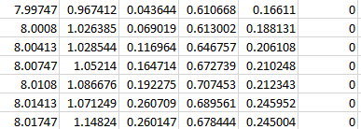
Export total digit forces
export_digit_forces.py
Same is done for each digit segment.

Slide 48
Associated functions
inspect_object_endpoints.py
shows variability in the locations of thorax (base body) and pressure sensors during grasp.
Manual adjustment of sensor location – not used anymore
find_optimal_frames.py
make_adjustment.py
Most functions have --make_plots argument to provide some diagnostic information.

Slide 49
Validation
1. Matched segment-digit pairs

Slide 50
Manual force labelling
compare_masked_forces.py --find_good
Prints out lists of trials that were successful and had only a single grasp marked in manual log as good candidates for manual labeling and validation.

Slide 51
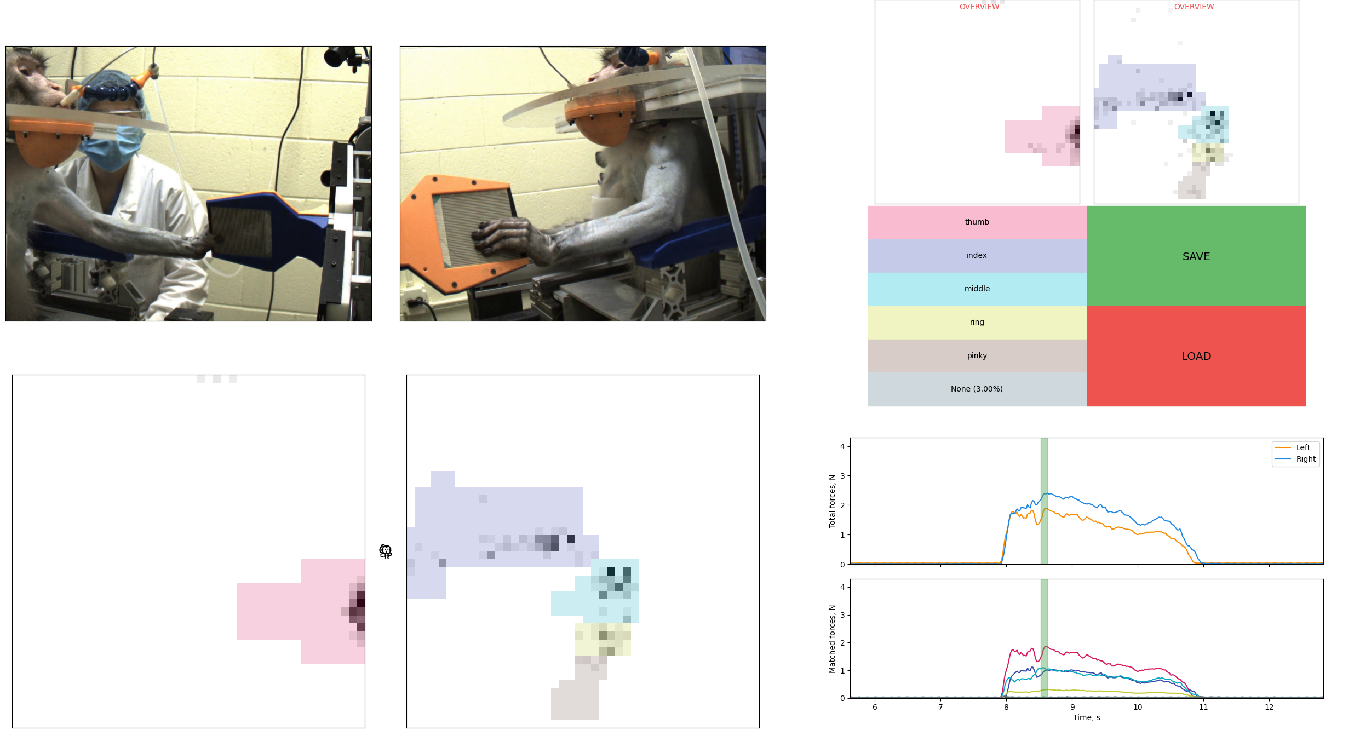
Manual force labelling
current view from two selected cameras
summary over the whole trial
if clicked, moves to the time with highest activity on the pixel
current frame (moveable)
manually selected finger area
already assigned digit force

Slide 52
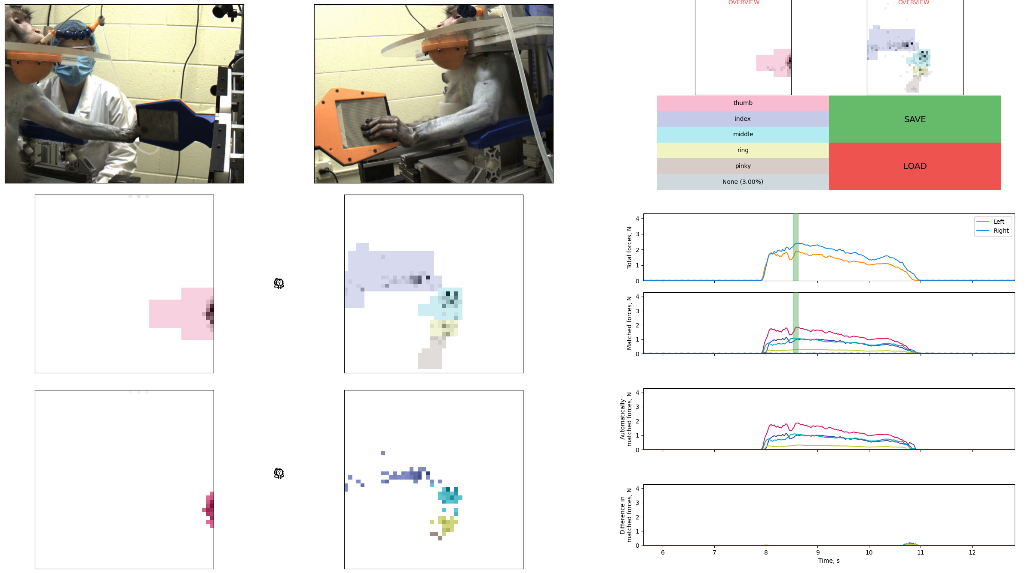
Option to compare against automatic
automatically-matched profiles
automatically-matched
difference in matched profiles

Slide 53
Comparison
compare_masked_forces.py
Finds the sensels that were misattributed to a different digit.
Prints a detailed report and figures.

Slide 54
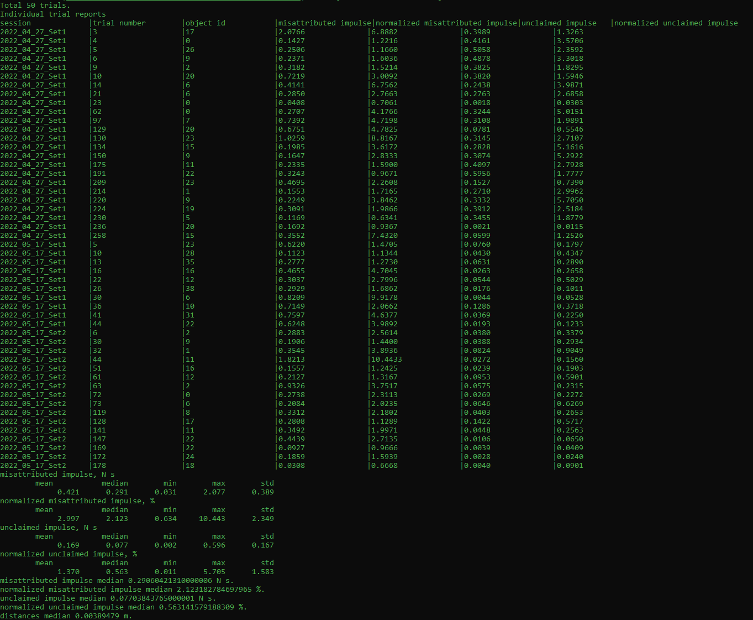
Report

Slide 55
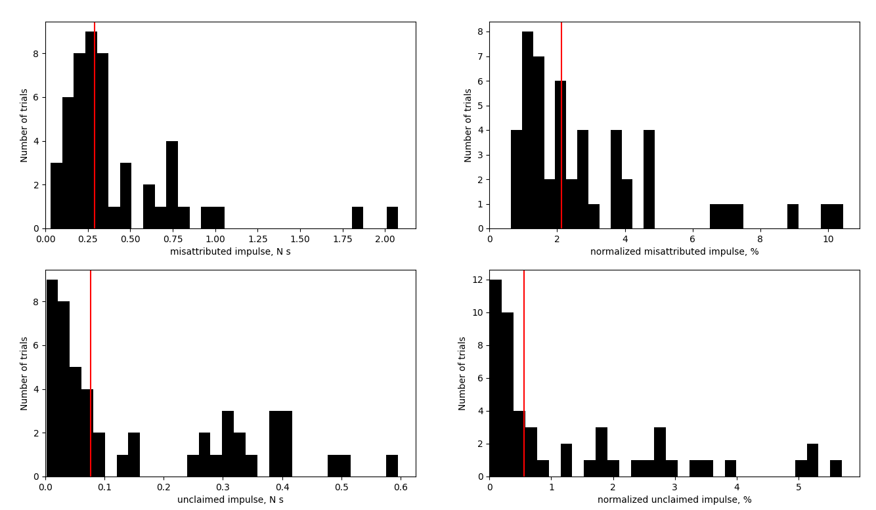
Comparison

Slide 56
Associated functions
compare_digit_forces.py
Compares the forces directly – way more metrics and will always show higher match.

Slide 57
FIN.

